Slide 1

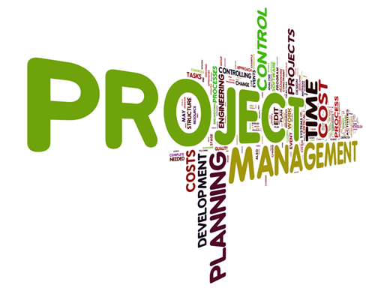
Techprojectshub
Project Title: Pregnancy Companion: An AI-Powered Support System for Women and Families
Domain: Mechine Learning, Ai, Deep Learning
techprojecthub

Slide 2
Abstract:
"Pregnancy Companion" is an innovative AI-powered support system designed to assist women and families throughout the pregnancy journey.
Utilizing advanced natural language processing (NLP) algorithms, the platform offers personalized guidance and resources tailored to individual needs.
By analyzing user queries and sentiments, "Pregnancy Companion" delivers relevant information, ranging from health and nutrition tips to emotional support and community connections.
The system enhances user interaction through conversational interfaces, making it easy for expectant mothers to access timely advice and answers to common questions.
Additionally, the platform fosters a supportive community environment, allowing users to share experiences and connect with others.
Ultimately, "Pregnancy Companion" aims to empower women and families by enhancing their overall pregnancy experience, ensuring they feel informed, supported, and connected at every stage.
techprojecthub

Slide 3
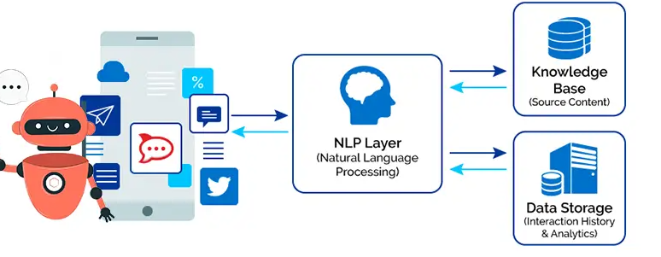
System architecture
techprojecthub

Slide 4
ProjectOutcome:
1. **Enhanced User Engagement:** The system will foster a supportive community, encouraging expectant mothers and families to actively engage, share experiences, and provide mutual support.
2. **Personalized Support:** By leveraging NLP algorithms, the platform will deliver tailored advice and resources, addressing the unique needs and concerns of each user throughout their pregnancy journey.
3. **Improved Information Access:** Users will have easy access to accurate and relevant information regarding health, nutrition, and emotional well-being, reducing anxiety and enhancing confidence during pregnancy.
4. **Increased Awareness and Education:** The project will promote awareness about pregnancy-related topics, empowering users with knowledge and resources to make informed decisions for their health and well-being.
techprojecthub

Slide 5
System requirements
Front end technology: Html, Css
Back end technology: Python
Framework : Django
Database: Mysql
techprojecthub

